Slide 1







SpaceX Falcon9 Data Analysis
Nousheen Ali
05-OCT-2021

Slide 2



OUTLINE
Executive Summary
Introduction
Methodology
Data Collection(REST API, Web scraping)
Data Wrangling
Exploratory Data Analysis
Interactive Visual Analytics
Predictive Analysis
Results
Visualization – Charts, SQL,
Interactive Map with Folium
Plotly Dashboard
Predictive Analysis
Conclusion

Slide 3

EXECUTIVE SUMMARY
Space travel has always been a dream for the human race. In the last decade, however, this dream is turning to a reality with the help of companies such as SpaceX, Blue Origin and Virgin Galactic.
SpaceX has been the most successful in this field. SpaceX advertises Falcon 9 rocket launches on its website, with a cost of 62 million dollars where other providers cost upward of 165 million dollars each.
This project will do a case study on SpaceX Falcon9 to come up with a Machine Learning Model.

Slide 4

INTRODUCTION
SpaceX Falcon 9 are able to provide relatively cheaper rates because it can recover the first stage of the rocket unlike its peers.
The first stage of the rocket does most of the work and is much larger and expensive than the second stage.
However in some cases SpaceX is not able to save stage one of the rocket.
This project will analyse the available data from the previous launches to predict if Falcon 9 first stage will land successfully.
This process involves Data Collection, Handling Nulls,Data Analysis,Predictive Analysis etc.

Slide 5

METHODOLOGY – Data Collection(REST API)
First step of developing a machine learning model is Data Collection.
An increasing popular method for collecting data online is via a Representational State Transfer Application Program Interface (REST API/ simply API).
This refers to a set of protocols that a user can use to query a web service for data. Many organizations make their data available through an API.
In this case we use the SpaceX REST API to extract data. The reponse is in the form of a JSON file.
A DataFrame is created from the JSON data,after which the missing values are handled.

Slide 6
METHODOLOGY – Web Scraping
Alternatively we can use Web scraping to extract data from HTML pages.
In our case:
Collect Falcon 9 historical launch records from a Wikipedia page titled `List of Falcon 9 and Falcon Heavy launches`
Create Dataframe by parsing through the HTML tables

Slide 7
METHODOLOGY – Data Wrangling
Data wrangling is the process of cleaning, structuring and enriching raw data into a desired format for better decision making in less time.
An additional column by the name 'class' was added to the data to indicate landing outcome.
0 indicating failure
1 indicating success
This step involves handling missing data as well.

Slide 8
METHODOLOGY – Exploratory Data Analysis (EDA)
Exploratory Data Analysis refers to the critical process of performing initial investigations on data so as to discover patterns,to spot anomalies,to test hypothesis and to check assumptions with the help of summary statistics and graphical representations.
EDA using SQL
Data made available in .csv format is stored in a SQL table then exploratory analysis is performed with the help of SQL queries.
EDA with Data Visualization
Visualization method is used to understand the relation between various features through graphs,bar charts etc.
It provides insights about how each variable would affect the success rate. Thereby help us select the features for success prediction in the future module (Feature Engineering).

Slide 9
METHODOLOGY – Interactive Visual Analytics
Interactive Visual Analytics(through dashboards) enables visualization, interaction, and automatic computation to facilitate insight generation and knowledge crystallization from data.
It presents data in such a manner that it is more understandable and appealing and helps to filter data in real time.
To create a dashboard, one can use
Folium
Analyze Launch Site Geo Data to discover patterns while exploring the map
Plotly Dash

Slide 10
METHODOLOGY – Predictive Analysis
Predictive Analysis makes predictions about future outcomes using historical data combined with statistical modeling and machine learning techniques.
Our assignment here is to build a model to predict if SpaceX Falcon 9 will land successfully or not.
The steps involve
Preprocessing: Standardizing the data
Train Test Split : Splitting data to train and subsequently test the model.
We train the model and perform Gridsearch to find hyperparameters that helps the algorithm perform its best
With the best hyperparameter values we find apt model with best accuracy using test data.
Model used : Logistic Regression, Support Vector Machine(SVM), Decision Tree Classifier, K Nearest Neighbour(KNN)

Slide 11
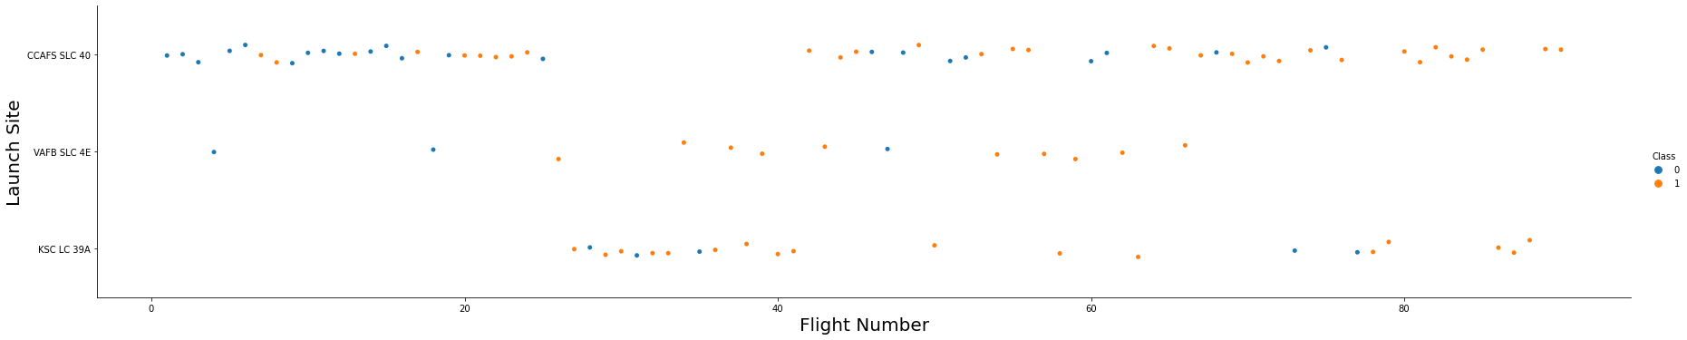
RESULTS – EDA using Visualization
Relationship between Flight Number and Launch Site
With increase in number of flights the success rate is seen to increase.

Slide 12
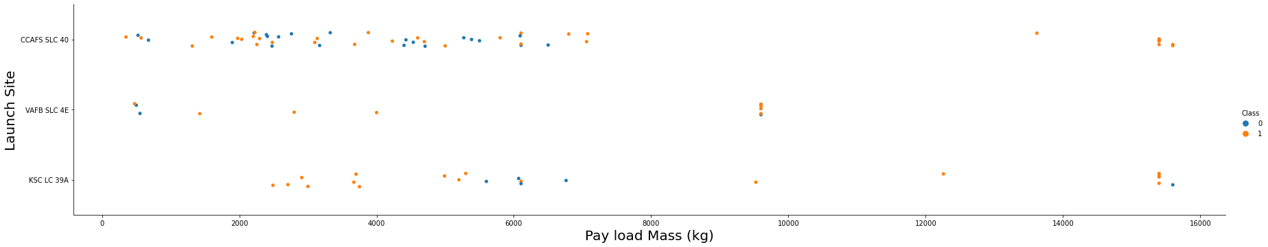
RESULTS – EDA using Visualization
Relationship between Payload and Launch Site
With increase in payload mass the success rate is seen to increase.

Slide 13
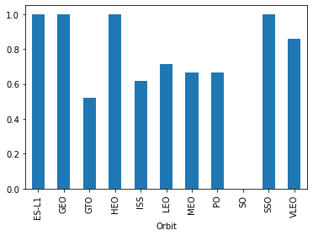
RESULTS – EDA using Visualization
Relationship between success rate of each orbit type
GEO, HEO, SSO,ES-L1 orbits have 100% success rate
GTO orbit has the lowest success rate of 50 %

Slide 14
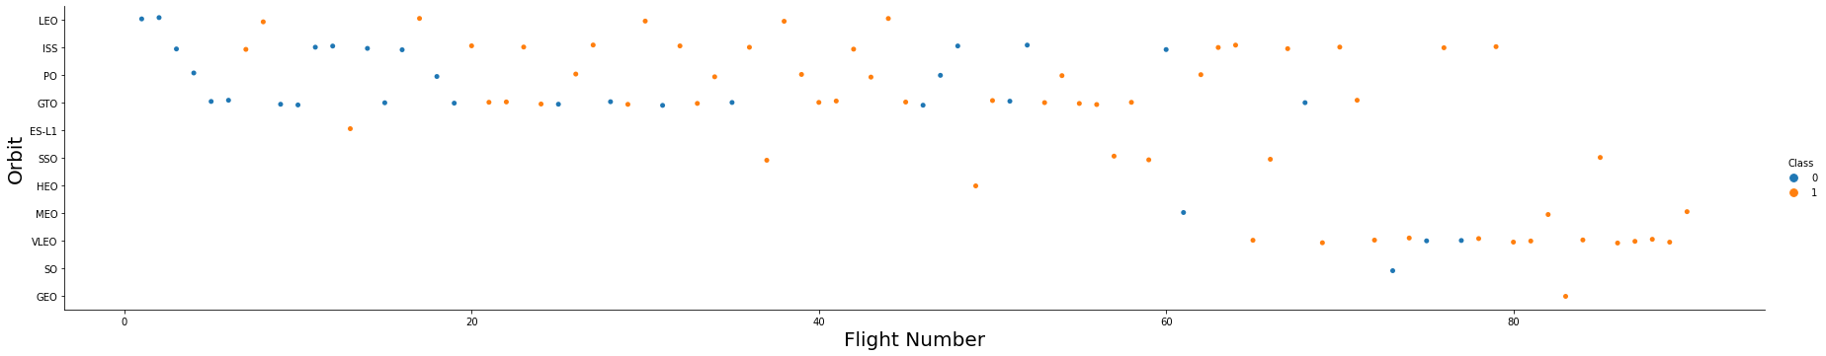
RESULTS – EDA using Visualization
Relationship between FlightNumber and Orbit type
For LEO orbit the Success appears related to the number of flights; on the other hand, there seems to be no relationship between flight number when in GTO orbit.

Slide 15
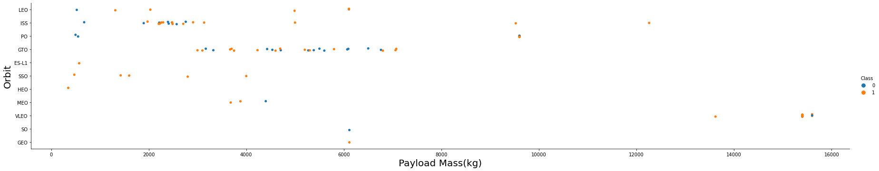
RESULTS – EDA using Visualization
Relationship between Payload and Orbit Type
It is observed that heavy payloads have a negative influence on GTO orbits and positive on GTO and Polar LEO (ISS) orbits.

Slide 16
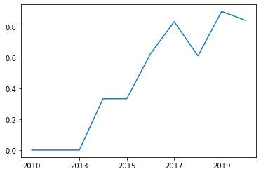
RESULTS – EDA using Visualization
Success Rate – Yearly Trend
It is observed that the sucess rate since 2013 kept increasing till 2020

Slide 17
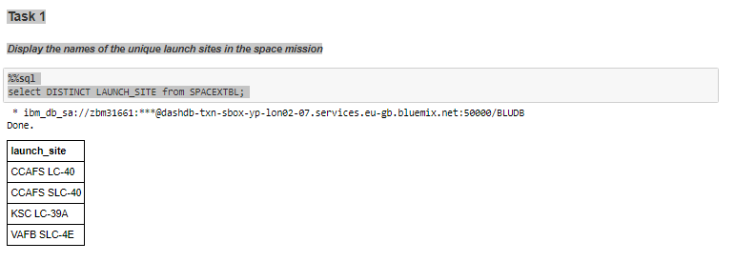
RESULTS – EDA using SQL

Slide 18
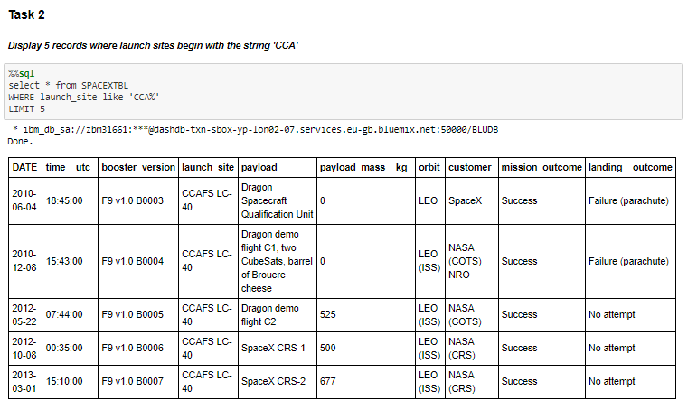
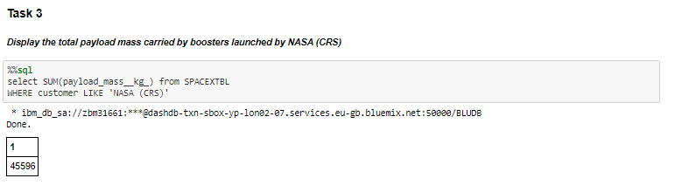

Slide 19
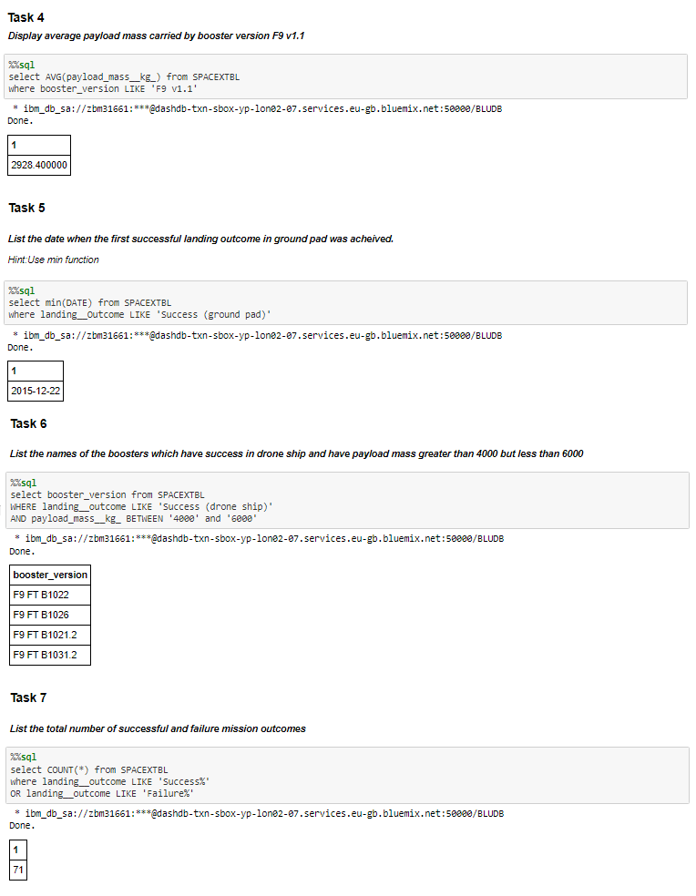

Slide 20
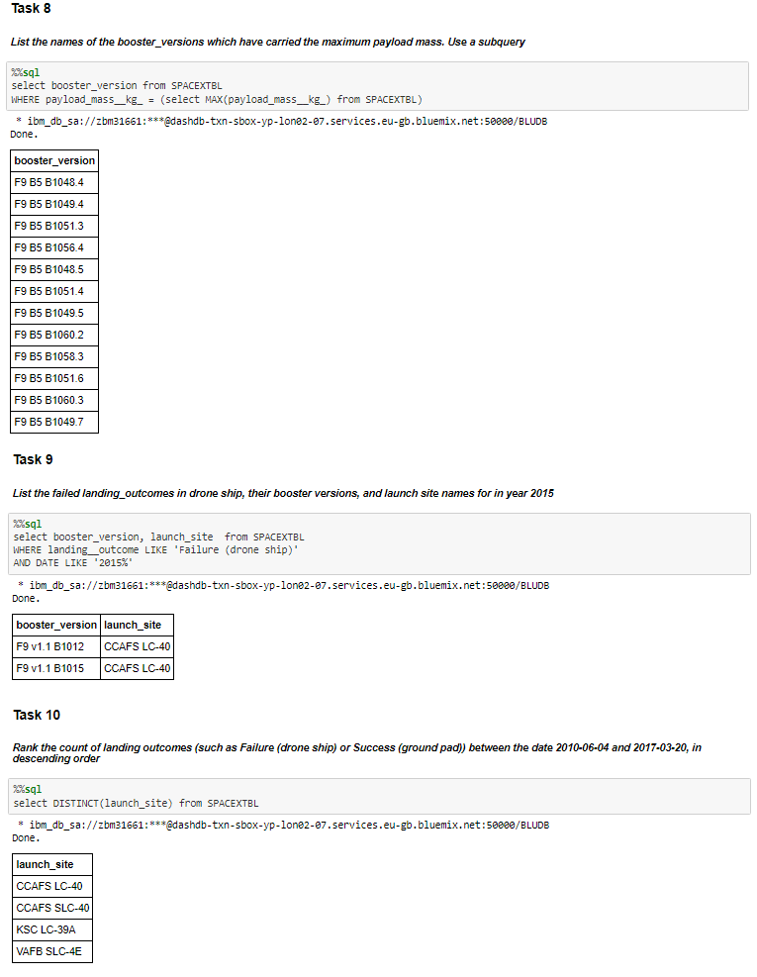

Slide 21
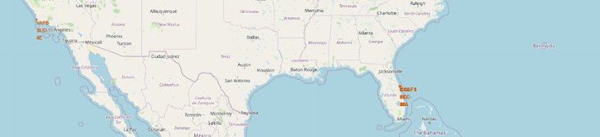
RESULTS – Interactive Map With Folium
The map generated using folium with marked launch sites.

Slide 22
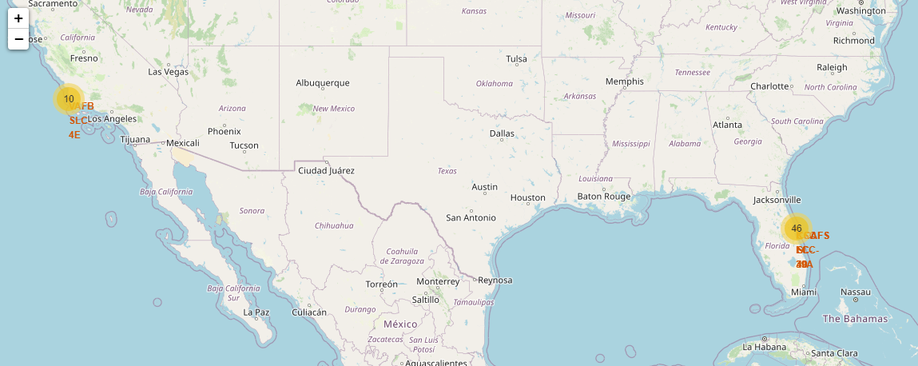
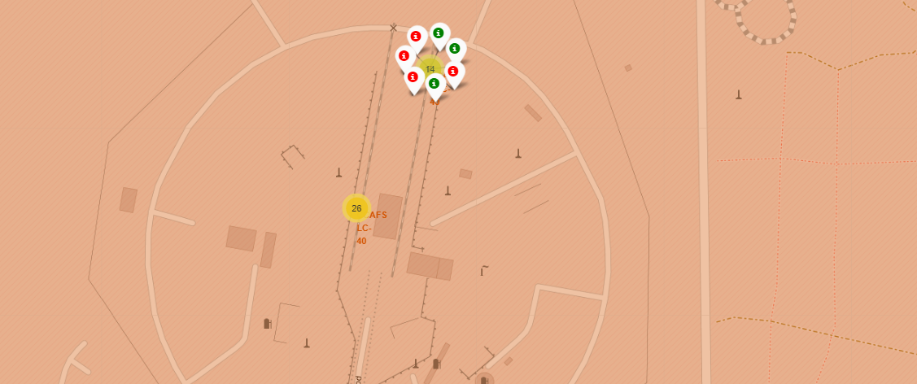
RESULTS – Interactive Map With Folium
Markers to show successful/failed launches for each site on the map.
The first figure shows the total launches in each site.
When zoomed in, each site shows the successful launches in green and failed ones in red

Slide 23
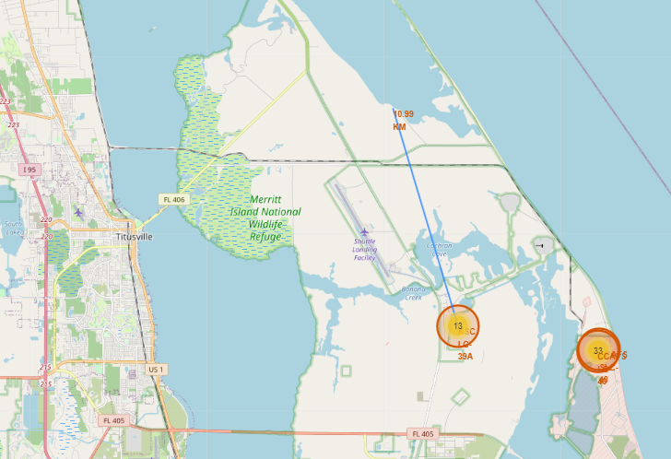
RESULTS – Interactive Map With Folium
Calculate the distances between a launch site to its proximities

Slide 24
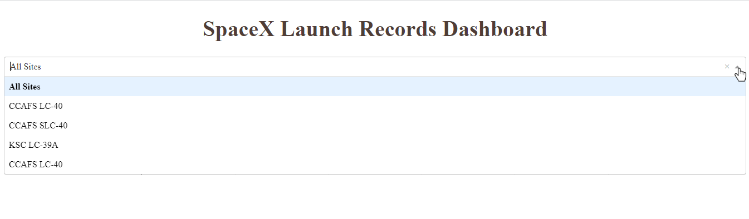
RESULTS – Plotly Dashboard
The Plotly Dashboard consists of drop down to select the launch site name.

Slide 25
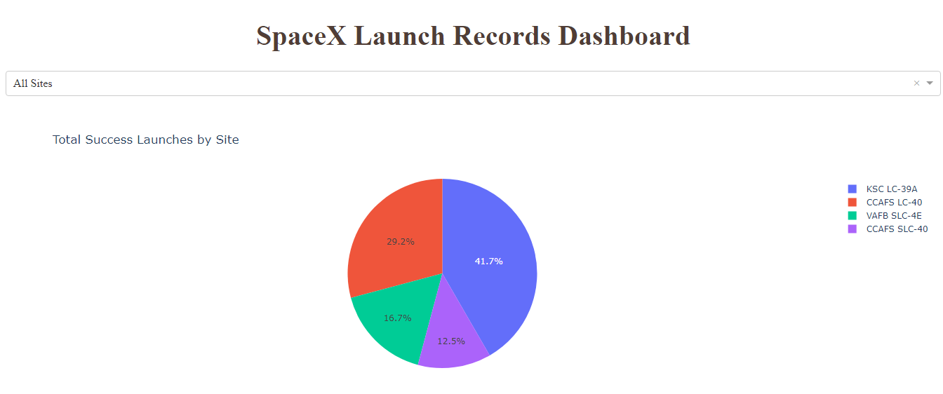
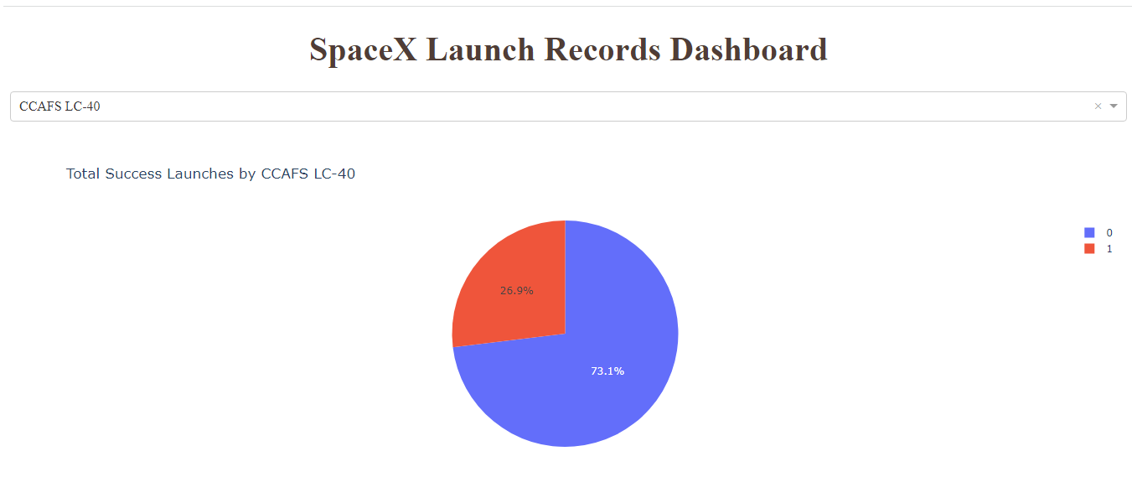
RESULTS – Plotly Dashboard
Success pie chart based on selected launch site
If ALL sites are selected, the pie chart graph shows the total success launches by each site.
If any one site is selected, the pie chart displays the percentage of successes and failures.

Slide 26
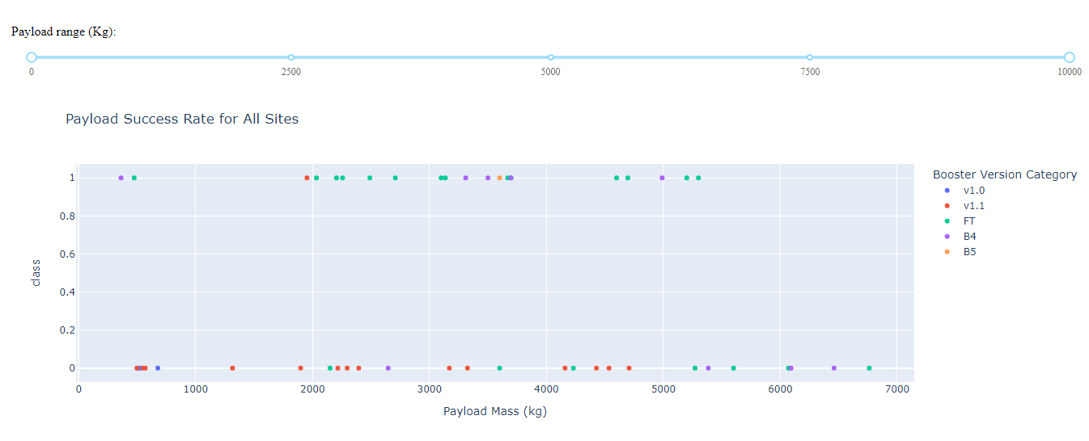
RESULTS – Plotly Dashboard
The slider helps to select the payload range.
The scatter plot helps us visually observe how payload may be correlated with mission outcomes for selected site(s).

Slide 27
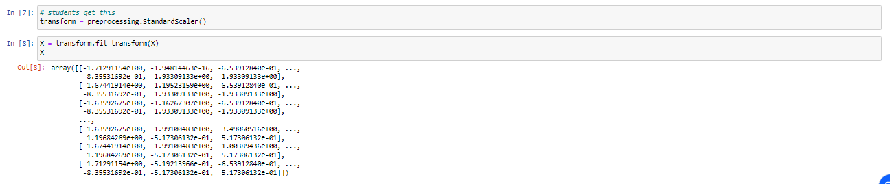
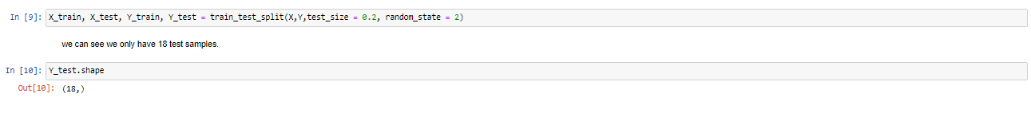
RESULTS – Predictive Analysis
Preprocessing
This step involves normalising the data using StandardScalar function
Then splitting the data into train and test sets.

Slide 28

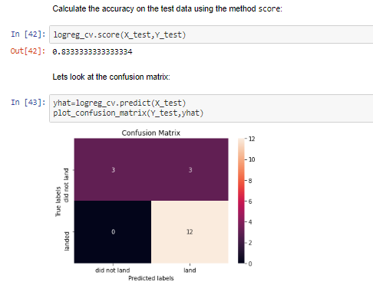
RESULTS – Predictive Analysis
Logistic Regression
Using training data on Gridsearch we obtain the best parameters.
'C': 0.01
'penalty': 'l2'
'solver': 'lbfgs'
With the best parameters, logistic regression model gives an accuracy of 83.33% for test data.
Examining the confusion matrix, we see that logistic regression can distinguish between the different classes. We see that the major problem is false positives.

Slide 29

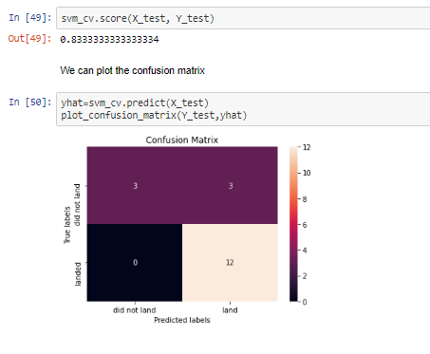
RESULTS – Predictive Analysis
Support Vector Machine(SVM)
Using training data on Gridsearch we obtain the best parameters.
'C': 0.03162277660168379
'gamma': 0.001
'kernel': 'linear'
With the best parameters, SVM model gives an accuracy of 83.33% for test data.

Slide 30
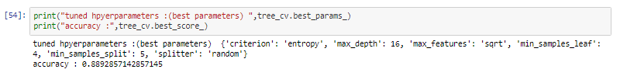
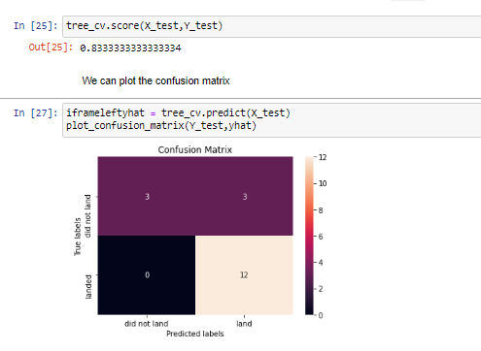
RESULTS – Predictive Analysis
Decision Tree Classifier
Using training data on Gridsearch we obtain the best parameters.
'criterion': 'entropy', 'max_depth': 6, 'max_features': 'sqrt', 'min_samples_leaf': 4, 'min_samples_split': 2, 'splitter': 'best'
With the best parameters, this model gives an accuracy of 83.3% for test data.

Slide 31
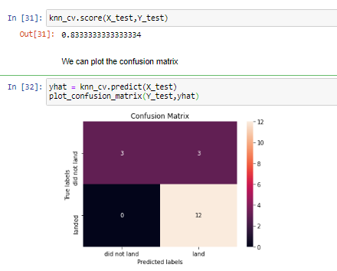
RESULTS – Predictive Analysis
K Nearest Neighbor(KNN)
Using training data on Gridsearch we obtain the best parameters.
'algorithm': 'auto'
'n_neighbors': 10
'p': 1
With the best parameters, this model gives an accuracy of 83.3% for test data.

Slide 32
RESULTS – Predictive Analysis
All the models below mentioned models give the same accuracy of 83.3% for test Data.
Logistic Regression
Support Vector Machine
Decision Tree Classifier
K Nearest Neighbor

Slide 33

CONCLUSION
The features FlightNumber, PayloadMass, Orbit and LaunchSite influence the success/failure of the launch.
Site KSC LC-39A contributed to 41.7% of the successful launches. Out of the total number of its launches, 76.9% being successful.
Booster version 'FT' has had the most successes for the payload range 2K to 6K.
All the machine learning models(Logistic regression, SVM, Decision Tree and KNN) are equally good as they all provide the same accuracy of 83.3%.

Slide 34
THANK YOU

